Slide 1
Algoritma & Pemrograman
Operators for Fundamental Types
Prepared by
Frans Panduwinata, S.Kom, M.T

Slide 2

Binary Operator and Operands

Slide 3
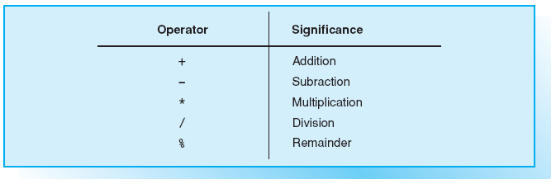
Binary Arithmetic Operators

Slide 4
Binary Arithmetic Operators (cont)
Arithmetic operators are used to perform calculations.
  Divisions performed with integral operands will produce integral results;
  For EXAMPLE,
  7/2 computes to 3.
  If at least one of the operands is a floating-point number,
  the result will also be a floating-point number;
  e.g., the division 7.0/2 produces an exact result of 3.5.

Slide 5
Binary Arithmetic Operators (cont)
Arithmetic operators are used to perform calculations (cont).
  Remainder division is only applicable to integral operands and returns the remainder of an integral division.
  For EXAMPLE,
  7%2 computes to 1.

Slide 6
Expressions
In its simplest form an expression consists of only one constant, one variable, or one function call.
In the case of arithmetic expressions, the operands define the type of the expression.
EXAMPLES:
int a(4); double x(7.9);
a * 512 // Type int
1.0 + sin(x) // Type double
x – 3 // Type double, since one
// operand is of type double

Slide 7
Expressions (cont)
An expression can be used as an operand in another expression.
EXAMPLE:
2 + 7 * 3 // Adds 2 and 21

Slide 8
Expressions (cont)
Normal mathematical rules (multiplication before addition) apply when evaluating an expression,
i.e. the *, /, % operators have higher precedence than + and -.
However, you can use parentheses to apply a different precedence order.
EXAMPLE :
(2 + 7) * 3 // Multiplies 9 by 3.

Slide 9
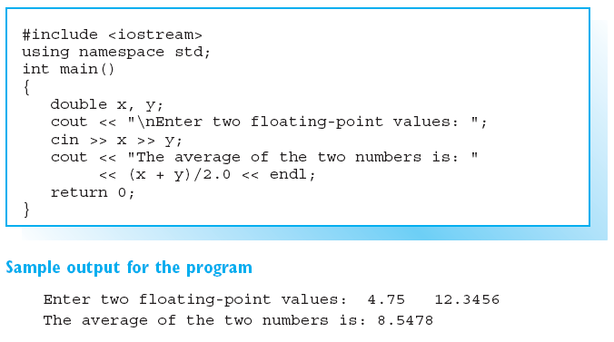
Sample Program

Slide 10

Unary Arithmetic Operators

Slide 11
Sign Operators
The sign operator (–) returns the value of the operand but inverts the sign.
EXAMPLE:
int n = –5; cout << -n; // Output: 5
The sign operator + performs no useful operation, simply returning the value of its operand.

Slide 12
Increment / Decrement Operators
The increment operator ++ modifies the operand by adding 1 to its value
Given that i is a variable,
  both i++ (POSTFIX notation) and ++i (PREFIX notation) raise the value of i by 1.
  In both cases the operation i = i + 1 is performed.

Slide 13
Increment / Decrement Operators (cont)
However, prefix ++ and postfix ++ are two different operators.
The difference becomes apparent when you look at the value of the expression;
  ++i means that the value of i has already been incremented by 1, whereas
  the expression i++ retains the original value of i.

Slide 14
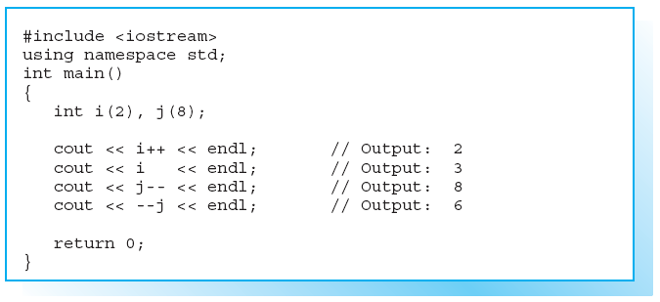
Effects of Prefix and Postfix Notation

Slide 15
Precedence
How is an expression with multiple operators evaluated?
EXAMPLE:
float val(5.0);
cout << val++ – 7.0/2.0;
Operator precedence determines the order of evaluation, i.e. how operators and operands are grouped.
EXAMPLE:
(val++) – (7.0/2.0).
The result is 1.5, as val is incremented later.

Slide 16
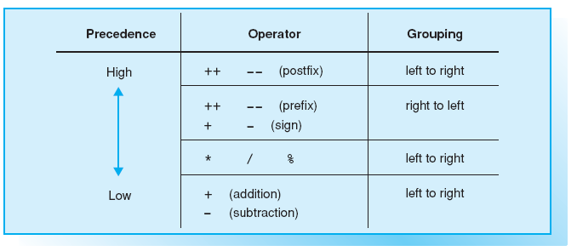
Precedence of Arithmetic Operators
Example if two operators have equal precedence:
3 * 5 % 2 is equivalent to (3 * 5) % 2

Slide 17
Simple Assignments
A simple assignment uses the assignment operator = to assign the value of a variable to an expression.
EXAMPLES:
z = 7.5;
y = z;
x = 2.0 + 4.2 * z;

Slide 18
Simple Assignments (cont)
Each assignment is an expression in its own right, and its value is the value assigned.
EXAMPLE:
sin(x = 2.5);
In this assignment the number 2.5 is assigned to x and then passed to the function as an argument.

Slide 19
Simple Assignments (cont)
Multiple assignments, which are always evaluated from right to left, are also possible.
EXAMPLE :
i = j = 9;
In this case the value 9 is first assigned to j and then to i.

Slide 20
Compound Assignments
Compound assignment operators simultaneously perform an arithmetic operation and an assignment.
EXAMPLES:
i += 3; is equivalent to i = i + 3;
i *= j + 2; is equivalent to i = i * (j+2);
The following compound operators are thus available:
+=, -=, *=, /=, and %=

Slide 21
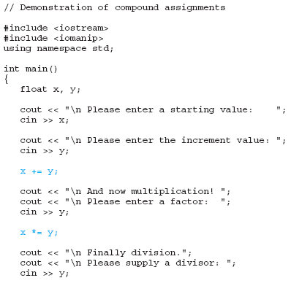
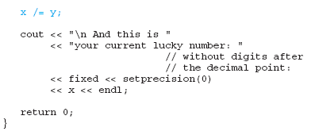
Sample Program

Slide 22
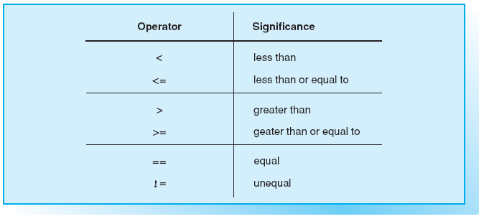
Relational Operators

Slide 23
The Result of Comparisons
Each comparison in C++ is a bool type expression with a value of true or false,
EXAMPLE:
length == circuit // false or true
  If the variables length and circuit contain the same number, the comparison is true and the value of the relational expression is true.
  But if the expressions contain different values, the value of the expression will be false.

Slide 24
The Result of Comparisons (cont)
When individual characters are compared, the character codes are compared.
The following expression results in the value true when ASCII code is used.
EXAMPLE:
A' < 'a' // true, since 65 < 97

Slide 25
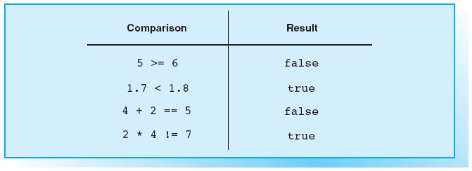
Examples for comparisons

Slide 26
Precedence of Relational Operators
Relational operators have lower precedence than arithmetic operators but higher precedence than assignment operators.
EXAMPLE:
bool flag = index < max – 1;
  max – 1 is evaluated first,
  then the result is compared to index, and
  the value of the relational expression (false or true) is assigned to the flag variable.

Slide 27
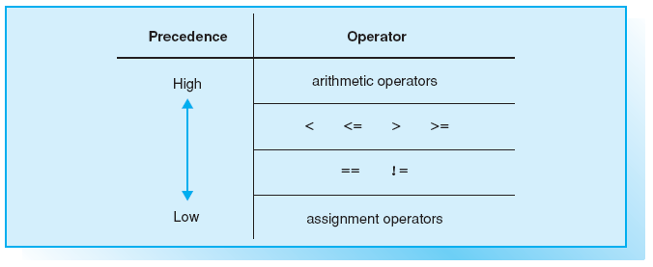
Precedence of Relational Operators (cont)

Slide 28
Precedence of Relational Operators (cont)
EXAMPLE:
int result;
result = length + 1 == limit;
  length + 1 is evaluated first,
  then the result is compared to limit, and
  the value of the relational expression is assigned to the result variable.
  Since result is an int type, a numerical value is assigned instead of false or true,
  i.e. 0 for false and 1 for true.

Slide 29
Precedence of Relational Operators (cont)
It is quite common to assign a value before performing a comparison, and parentheses must be used in this case.
EXAMPLE:
(result = length + 1) == limit
Our example stores the result of length + 1 in the variable result and then compares this expression with limit.

Slide 30
Operands and Order of Evaluation
The operands for boolean type operators are of the bool type.
The OR operator || will return true only if at least one operand is true, so the value of the expression
EXAMPLE:
(length < 0.2) || (length > 9.8)
is true if length is less than 0.2 or greater than 9.8.

Slide 31
Operands and Order of Evaluation (cont)
The AND operator && will return true only if both operands are true, so the logical expression
EXAMPLE:
(index < max) && (cin >> number)
is true, provided index is less than max and a number is successfully input.
If the condition index < max is not met, the program will not attempt to read a number!

Slide 32
Operands and Order of Evaluation (cont)
One important feature of the logical operators && and || is the fact that
  there is a fixed order of evaluation.
  The left operand is evaluated first and if a result has already been ascertained, the right operand will not be evaluated!
The NOT operator ! will return true only if its operand is false.
  If the variable flag contains the value false (or the value 0),
  !flag returns the boolean value true.

Slide 33
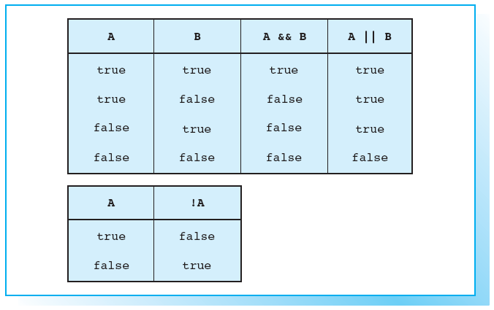
“Truth” Table for Logical Operators
The logical operators
comprise the boolean
operators
&& (AND), || (OR), and
! (NOT).

Slide 34
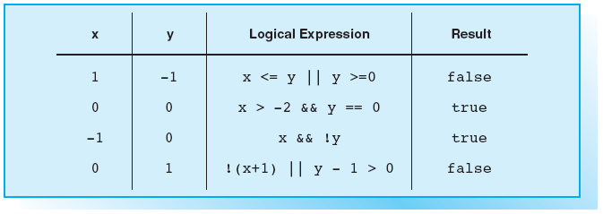
Examples for Logical Expressions

Slide 35
Precedence of Boolean Operators
The && operator has higher precedence than ||.
The precedence of both these operators is
  higher than the precedence of an assignment operator, but
  lower than the precedence of all previously used operators.
  This is why it was permissible to omit the parentheses.
The ! operator is a unary operator and thus has higher precedence.

Slide 36
Exercises
EXERCISE 1
What values do the following arithmetic expressions have?
a. 3/10 b. 11%4 c. 15/2.0
d. 3 + 4 % 5 e. 3 * 7 % 4 f. 7 % 4 * 3

Slide 37
Exercises (cont)
EXERCISE 2
How are operands and operators in the following expression
associated?
x = –4 * i++ – 6 % 4;
Insert parentheses to form equivalent expressions.
What value will be assigned in part a to the variable x if the variable
i has a value of –2?

Slide 38
Exercises (cont)
EXERCISE 3
The int variable x contains the number 7. Calculate the value of the
following logical expressions:
a. x < 10 && x >= –1
b. !x && x >= 3
c. x++ == 8 || x == 7

Slide 39
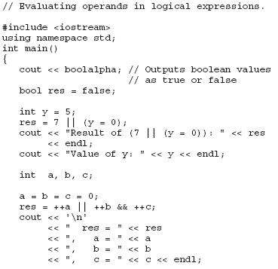
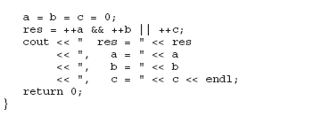
Exercises (cont)
EXERCISE 4
What screen output does the
program generate?
Examine the results!

